Slide 1
Part II
Project Planning

Slide 2
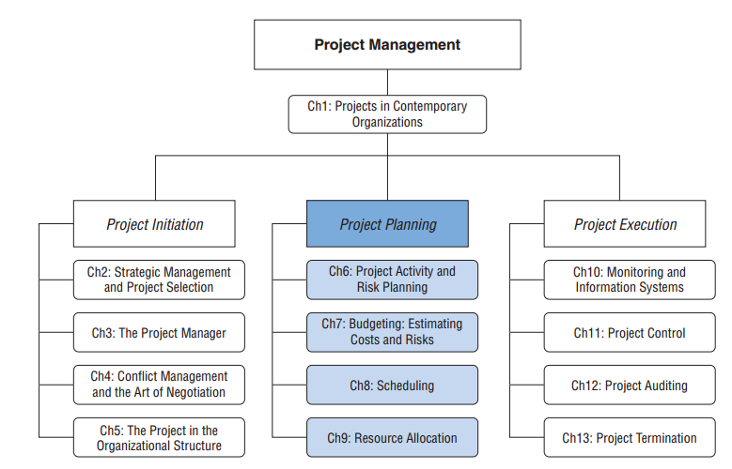
Project Management
6-<number>

Slide 3
Chapter 6
Activity Planning: Traditional and Agile

Slide 4
Initial Project Coordination and the Project Charter
Early meetings are used to decide on participating in the project
Used to “flesh out” the nature of the project
Planning is done to facilitate later accomplishment
Outcomes include:
  Technical scope
  Areas of responsibility
  Delivery dates or budgets
  Risk management group
6-<number>

Slide 5
Traditional Project Activity Planning
Project objectives should be tied to the overall mission, goals and organizational strategy.
“Launch meetings”
  Important for a senior manager to attend
  Success of “launch” meetings dependent on well-defined objectives
  Useful to review major risks facing the project now
  Don’t let plans, schedules, and budgets go beyond the most aggregated levels at this point
6-<number>

Slide 6
Outside Clients
When it is for outside clients, specifications cannot be changed without the client’s permission
Client may place budget constraints on the project
May be competing against other firms
6-<number>

Slide 7
Project Charter Elements
Purpose
Objectives
Overview
Schedules
Resources
Stakeholders
Risk management plans
Evaluation methods
6-<number>

Slide 8
The Project Plan Addresses: (Slide 1 of 2)
The process for managing change
A plan for communicating with and managing stakeholders
Specifying the process for setting key characteristics of the project deliverable (technically referred to as configuration management)
Establishing the cost baseline for the project and developing a plan to manage project costs
Developing a plan for managing the human resources assigned to the project
Developing a plan for continuously monitoring and improving project work processes
6-<number>

Slide 9
The Project Plan Addresses: (Slide 2 of 2)
Developing guidelines for procuring project materials and resources
Defining the project’s scope and establishing practices to manage the project’s scope
Developing the Work Breakdown Structure
Developing practices to manage the quality of the project deliverables
Defining how project requirements will be managed
Establishing practices for managing risk
Establishing the schedule baseline and developing a plan to manage the project’s schedule
6-<number>

Slide 10
A Whole-Brain Approach to Project Planning
Project managers typically use left side of brain- logical and analytical
Should also use right side – creative
A whole-brained approach is mind mapping
6-<number>

Slide 11
Mind Mapping Advantages
It is a visual approach that mirrors how human brain records & stores information
It helps tap the creative potential of the entire project team
  helps increase quantity and quality of ideas
Team members find it enjoyable
Helps generate enthusiasm
Helps obtain buy-in from team members
6-<number>

Slide 12
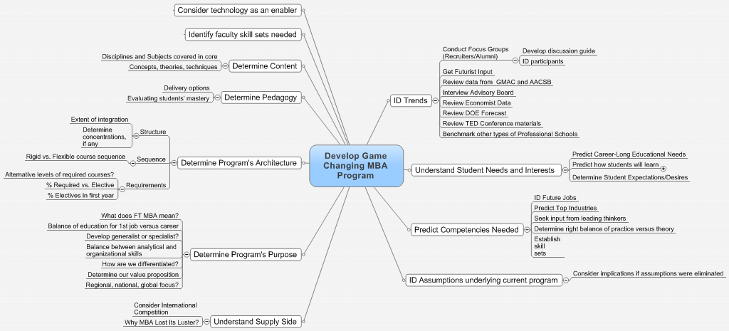
Final Mind Map for Full-Time MBA
6-<number>

Slide 13
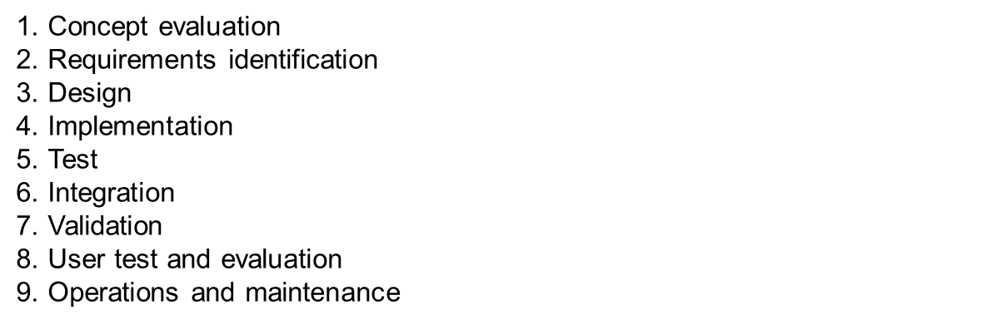
Project Planning in Action
Considers the sequence of activities required to carry the project from start to completion.
Software and hardware developers may divide the project into nine segments:
6-<number>

Slide 14
The WBS: A Key Element (Slide 1 of 2)
What is to be done
When it is to be started and finished
Who is going to do it
6-<number>

Slide 15
The WBS: A Key Element (Slide 2 of 2)
Some activities must be done sequentially
Some activities may be done simultaneously
Many things must happen when and how they are supposed to happen
Each detail is uncertain and subjected to risk
6-<number>

Slide 16
Hierarchical Planning
Major tasks are listed
Each major task is broken down into detail
This continues until all the activities to be completed are listed
Need to know which activities “depend on” other activities
6-<number>

Slide 17
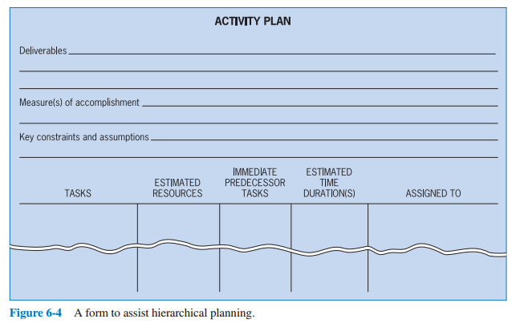
A Form to Assist Hierarchical Planning
6-<number>

Slide 18
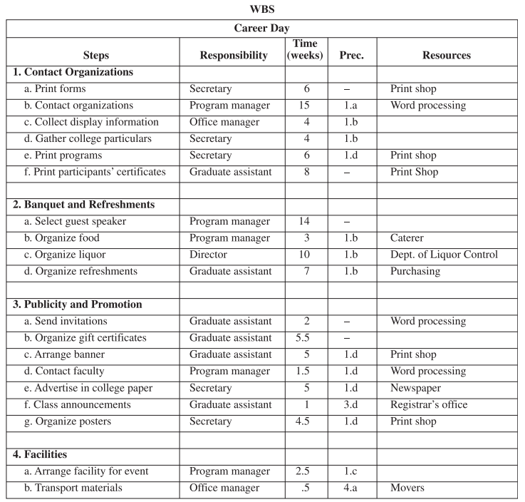
Career Day
6-<number>

Slide 19
The Work Breakdown Structure (WBS)
A hierarchical planning process
Breaks tasks down into successively finer levels of detail
Continues until all meaningful tasks or work packages have been identified
These make tracking the work easier
Need separate budget/schedule for each task or work package
6-<number>

Slide 20
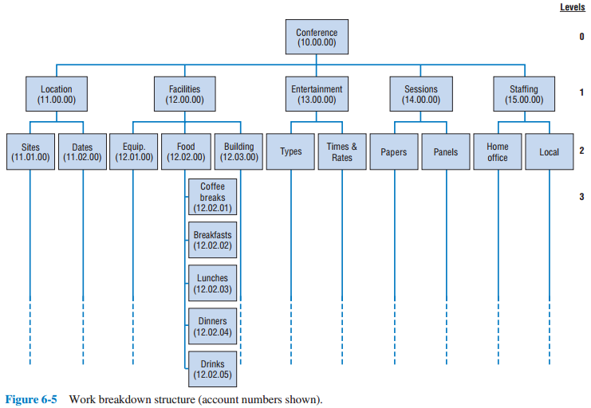
A Visual WBS
6-<number>

Slide 21
Steps to Create a WBS
List the task breakdown in successive levels
Identify data for each work package
Review work package information
Cost the work packages
Schedule the work packages
Continually examine actual resource use
Continually examine schedule
6-<number>

Slide 22
Human Resources
Useful to create a table that shows staff needed to execute WBS tasks
One approach is a organizational breakdown structure
  Organizational units responsible for each WBS element
  Who must approve changes of scope
  Who must be notified of progress
WBS and OBS may not be identical
6-<number>

Slide 23
The Responsibility (RACI) Matrix
Another approach is the Responsible, Accountable, Consult, Inform (RACI) matrix
  Also known as a responsibility matrix, a linear responsibility chart, an assignment matrix, a responsibility assignment matrix
Shows critical interfaces
Keeps track of who must approve and who must be notified
6-<number>

Slide 24
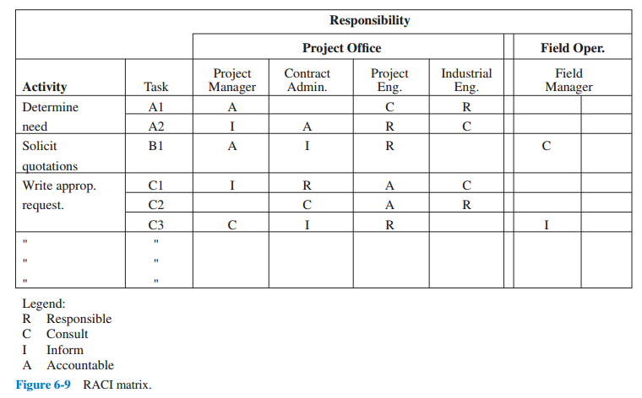
Sample RACI Matrix
6-<number>

Slide 25
Agile Project Planning and Management
Agile project management was developed to deal with two issues in IT:
  When scope cannot be determined in advance, traditional planning does not work
  Change is a constant
Small teams are located at a single site
Entire team collaborates
Utilizes sprints
Team deals with one requirement at-a-time with the scope frozen
Waterfall is a “batch process; APM is a flow process
6-<number>

Slide 26
12 Agile Principles (Slide 1 of 2)
1. Our highest priority is to satisfy the customer through early and continuous delivery of valuable software.
2. Welcome changing requirements, even late in development. Agile processes harness change for the customer’s competitive advantage.
3. Deliver working software frequently, from a couple of weeks to a couple of months, with a preference to the shorter timescale.
4. Business people and developers must work together daily throughout the project.
5. Build projects around motivated individuals. Give them the environment and support they need, and trust them to get the job done.
6. The most efficient and effective method of conveying information to and within a development team is face-to-face conversation.
6-<number>

Slide 27
12 Agile Principles (Slide 2 of 2)
7. Working software is the primary measure of progress.
8. Agile processes promote sustainable development. The sponsors, developers, and users should be able to maintain a constant pace indefinitely.
9. Continuous attention to technical excellence and good design enhances agility.
10. Simplicity--the art of maximizing the amount of work not done--is essential.
11. The best architectures, requirements, and designs emerge from self-organizing teams.
12. At regular intervals, the team reflects on how to become more effective, then tunes and adjusts its behavior accordingly.
6-<number>

Slide 28
Benefits of APM
Better project outcomes
Increased customer satisfaction
Improved morale
Increased collaboration and project visibility
6-<number>

Slide 29
Coordination Through Integration Management
Managing a project requires a great deal of coordination
Projects typically draw from many parts of the organization as well as outsiders
All of these must be coordinated
The RACI matrix helps the project manager accomplish this
6-<number>

Slide 30
Integration Management
Coordinating the work and timing of different groups
Interface coordination is the process of managing this work across multiple groups
Using multidisciplinary teams to plan the project
  Requires structure
6-<number>

Slide 31
Managing Projects by Phases and Phase-Gates
Break objectives into shorter term sub-objectives
Project life cycle is used for breaking a project up into component phases
Focus on specific, short-term output
Lots of feedback between disciplines
6-<number>

Slide 32
Copyright
Copyright © 2018 John Wiley & Sons, Inc.
All rights reserved. Reproduction or translation of this work beyond that permitted in Section 117 of the 1976 United States Act without the express written permission of the copyright owner is unlawful. Request for further information should be addressed to the Permissions Department, John Wiley & Sons, Inc. The purchaser may make back-up copies for his/her own use only and not for distribution or resale. The Publisher assumes no responsibility for errors, omissions, or damages, caused by the use of these programs or from the use of the information contained herein.
Copyright ©2018 John Wiley & Son, Inc.

